Slide 1
Memory Hierarchy Design

Slide 2
Recall Pipeline Performance
Pipeline stages need to be balanced
the clock is fixed by the slowest stage.
Ideal case, every stage has same latency
In reality, stages are unbalanced
memory accesses are much slower
Example: MEM 10 ns latency, other stages 2 ns latency
clock cycle time = 10 ns
How do reduce MEM stage latency?
Memory hierarchy

Slide 3
A Simplified View of Computers
CPU
Memory
I$
D$
Main Memory
Interconnect
HD
DISP
...
KB
Notes:
Logically, memory viewed a mono block
Practically, memory organized with layers of different types of memory: SRAM for cache, DRAM for main memory, non-volatile memory (HD/Flash)

Slide 4
Objectives and Reading
Objectives
Understand memory hierarchy organizations and their impacts on performance
Evaluate performance tradeoffs of different memory hierarchy organizations
Reading
Computer Architecture: A Quantitative Approach
Appendix B, Chapter 2
Computer Organization and Design: The Hardware/Software Interface
Chapter 5

Slide 5
Memory Technology – Overview
Static RAM (SRAM)
0.5ns – 2ns, $2000 – $5000 per GB
Dynamic RAM (DRAM)
20ns – 30ns, $10 – $50 per GB
Flash – non-volatile
20 – 100 us, 5-10x cheaper than DRAM
Magnetic disk
5ms – 20ms, $0.20 – $2 per GB
Ideal memory
Access time of SRAM,
Capacity and cost/GB of disk
slower, cheaper
faster, costlier
Notes:
Flash memory is 1000x slower than DRAM, 1000x faster than HD

Slide 6
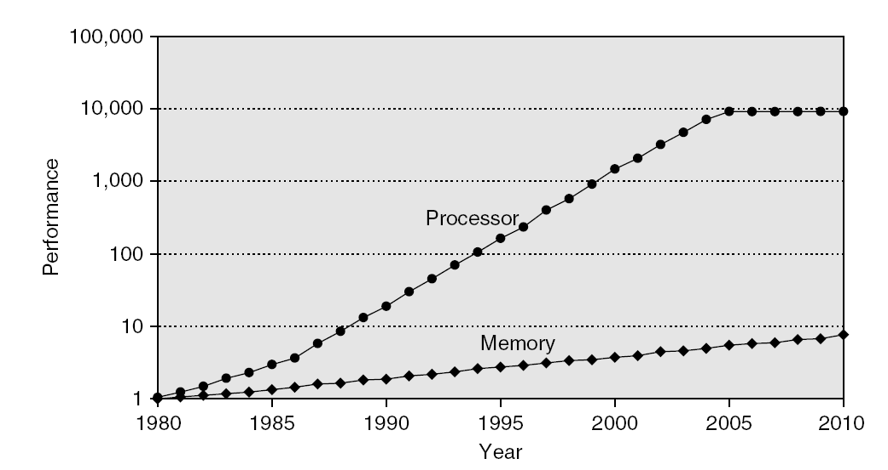
The “Memory Wall” Problem
Processor mem accesses/sec vs DRAM accesses/sec

Slide 7
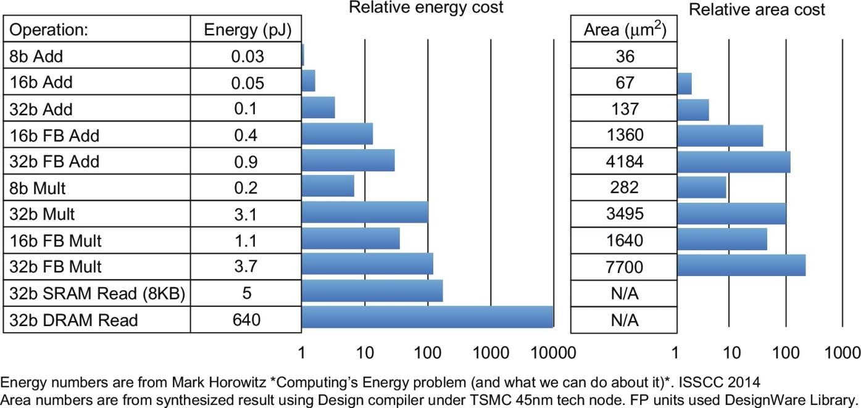
Computer Energy Usage
Notes:
What principles can we derive from this and previous slides?

Slide 8
The “Memory Wall” – A Multi-Core Case
Aggregate peak bandwidth grows with # cores:
Intel Core i7 can generate two references per core per clock
Four cores and 3.2 GHz clock
25.6 billion 64-bit data references/second +
12.8 billion 128-bit instruction references/second
= 409.6 GB/sec
DRAM bandwidth is only 6% of this (25 GB/s)
How does memory meet processor bandwidth demand?
Multi-port, pipelined caches
Two levels of cache per core
Shared third-level cache on chip
2.1 Introduction

Slide 9
Principle of Locality – Review
Temporal locality
Programs often access a small proportion of their address space at any time
Items accessed recently are likely to be accessed again soon
e.g., instructions and variables in a loop
Spatial locality
Items near those accessed recently are likely to be accessed soon
E.g., sequential instruction access, array data
B.1 Introduction
Notes:
locality is a property of applications

Slide 10
Principle of Locality – Review
Identify Temporal and spatial locality
int sum = 0;
int x[1000];
for (int c = 0; c < 1000; c++) {
sum += x[c];
x[c] = 0;
}
B.1 Introduction

Slide 11
Memory Hierarchy – Basic Idea
Ideally memory = unlimited capacity with low latency
Fast memory technology is more expensive per bit than slower memory
Solution: organize memory system into a hierarchy
Entire addressable memory space available in largest, slowest memory
Incrementally smaller and faster memories, each containing a subset of the memory below it, proceed in steps up toward the processor
Temporal and spatial locality ensures that nearly all references can be found in smaller memories
Gives the illusion of a large, fast memory being presented to the processor
2.1 Introduction
Notes:
locality: majority of memory accesses in a small space.

Slide 12
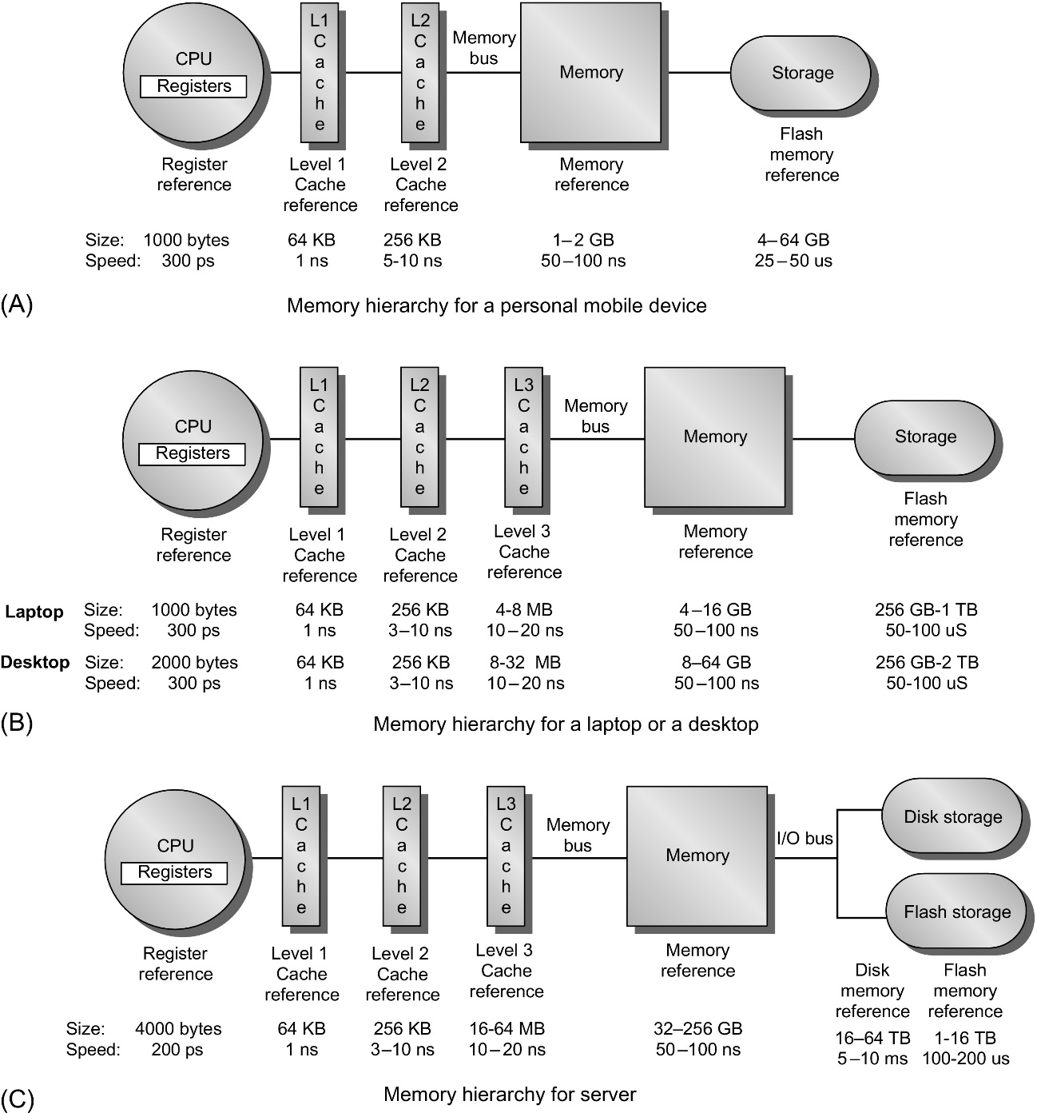
Memory Hierarchies
Mobile devices
Desktop
Servers
2.1 Introduction
Notes:
requirements of different applications → different mem hierarchy designs

Slide 13
Energy Consumptions
Song Han, FPGA’17 talk, “Deep Learning – Tutorial and Recent Trends”
More cache accesses lead to better efficiency
2.1 Introduction

